Slide 1
Apache Spark
Julien Heck
Hadoop and Managing Big Data
UCLA Extension

Slide 2
Apache Spark
Apache Spark is an open source cluster computing framework for large-scale data processing project that was started in 2009 at the University of California, Berkeley.
Spark was founded as an alternative to using traditional MapReduce on Hadoop, which was deemed to be unsuited for interactive queries or real-time, low-latency applications.
  A major disadvantage of Hadoop’s MapReduce implementation was its persistence of intermediate data to disk between the Map and Reduce processing phases.
Spark is closely integrated with Hadoop: it can run on YARN and works with Hadoop file formats and storage backends like HDFS.
Spark has more than 400 individual contributors and committers from companies such as Facebook, Yahoo!, Intel, Netflix, Databricks, and others.

Slide 3
Apache Spark
As an alternative to MapReduce, Spark implements a distributed, fault tolerant, in-memory structure called a Resilient Distributed Dataset (RDD).
Spark maximizes the use of memory across multiple machines, improving overall performance by orders of magnitude.
Spark’s reuse of these in-memory structures makes it well-suited to iterative, machine learning operations, as well as interactive queries.

Slide 4
Spark Architecture
A Spark application contains several components, all of which exist whether Spark is running on a single machine or across a cluster of hundreds or thousands of nodes.
The components of a Spark application are:
  The Driver Program and the SparkContext Object.
  The Cluster Manager.
  The Executor(s), which run on slave nodes or workers.

Slide 5
Driver Program
The life of a Spark application starts and finishes with the Driver Program or Spark driver.
The Spark driver is the process clients use to submit applications in Spark.
The driver is also responsible for planning and coordinating the execution of the Spark program and returning status and/or results (data) to the client.
The Spark driver is responsible for creating the SparkContext object.
The SparkContext is instantiated at the beginning of a Spark application (including the interactive shells) and is used for the entirety of the program.

Slide 6
Driver Program - Planning
One of the main functions of the driver is to plan the application.
The driver takes the application processing input and plans the execution of the program.
The driver takes all of the requested transformations (data manipulation operations) and actions (requests for output or a prompt to execute the program) and creates a Directed Acyclic Graph (DAG).

Slide 7
Directed Acyclic Graphs
A DAG is a mathematical construct that is commonly used in computer science to represent dataflows and their dependencies.
DAGs contain vertices or nodes and edges.
Vertices or nodes, in a dataflow context, are steps in the process flow.
Edges in a DAG connect vertices to one another in a directed orientation in such a way that it is impossible to have circular references.

Slide 8
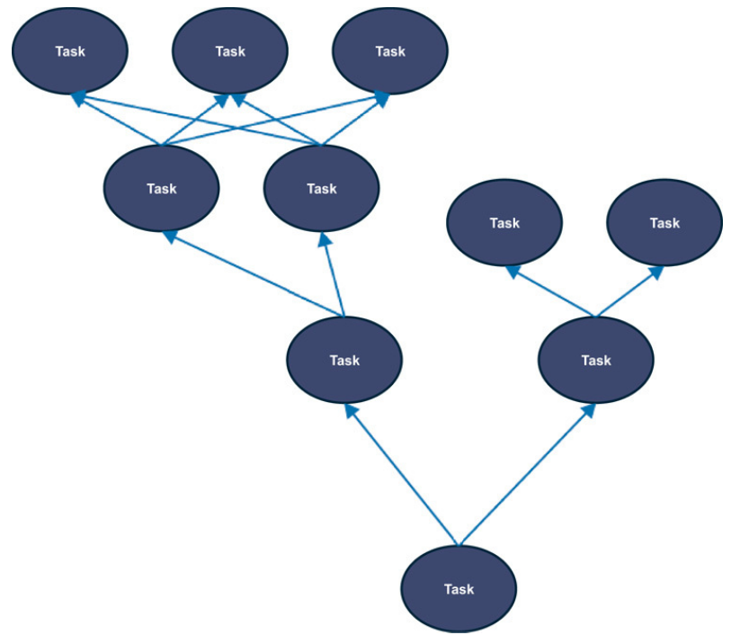
Directed Acyclic Graphs, cont.

Slide 9
Cluster Manager
To run on a cluster, the SparkContext can connect to several types of cluster managers (Spark’s standalone cluster manager, Mesos or YARN), which allocate resources across applications.
Spark is agnostic to the underlying cluster manager. As long as it can acquire executor processes, and these communicate with each other, it is relatively easy to run it even on a cluster manager that also supports other applications (e.g. Mesos/YARN).

Slide 10
Executors
Spark executors are the host processes on which tasks from a Spark DAG are run.
Executors reserve CPU and memory resources on slave nodes or workers in a Spark cluster.
Executors are dedicated to a specific Spark application and terminated when the application completes. A Spark executor can run hundreds or thousands of tasks within a Spark program.
A worker node or slave node, which hosts the executor process, has a finite or fixed number of executors that can be allocated at any point in time.
Executors store output data from tasks in memory or on disk.
Workers and executors are only aware of the tasks allocated to them, whereas the driver is responsible for understanding the complete set of tasks and their respective dependencies that comprise an application.

Slide 11
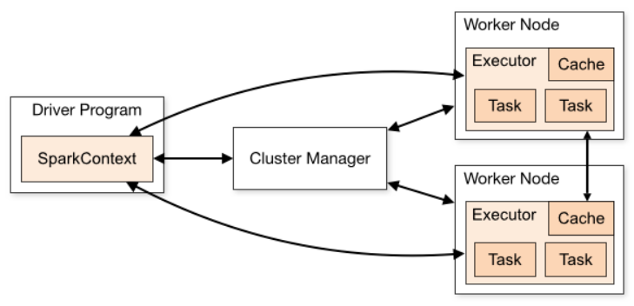
Spark Architecture - Overview

Slide 12
Resilient Distributed Dataset (RDD)
The Resilient Distributed Dataset (RDD) is the most fundamental data object used in Spark programming.
RDDs are datasets within a Spark application, including the initial dataset(s) loaded, any intermediate datasets, and the final resultant dataset(s).
Most Spark programming consists of creating new RDDs by performing operations on existing RDDs.
RDDs use various types of elements, from primitive datatypes such as integers, floating point numbers, and strings, to complex types such as lists or hashes, including nested objects, as well as serialized Scala and Java objects.
Although there are options for persisting RDDs to disk, RDDs are predominantly stored in memory (or are intended to be stored in memory, at least).

Slide 13
Resilient Distributed Dataset (RDD)
The term Resilient Distributed Dataset is an accurate and succinct descriptor for the concept. Here’s how it breaks down:
Resilient—RDDs are resilient, meaning that if a node performing an operation in Spark is lost, the dataset can be reconstructed. This is because Spark knows the lineage of each RDD, which is the sequence of steps to create the RDD.
Distributed—RDDs are distributed, meaning the data in RDDs is divided into one or many partitions and distributed as in-memory collections of objects across worker nodes in the cluster. As mentioned, RDDs provide an effective form of shared memory with which to exchange data between processes (executors) on different nodes (workers).
Dataset—RDDs are datasets that consist of records. Records are uniquely identifiable data collections within a dataset. Records could be a collection of fields similar to a row in a table in a relational database, a line of text in a file, or multiple other formats. RDDs are partitioned such that each partition contains a unique set of records and can be operated on independently: this is another example of the shared nothing approach.

Slide 14
Resilient Distributed Dataset (RDD)
Another key property of RDDs is their immutability, which means that after they are instantiated and populated with data, they cannot be updated.
New RDDs are created by performing coarse-grained transformations on existing RDDs in much the same way as bags in Pig are created by performing transformation on other bags.

Slide 15
Transformations and Actions
There are two types of operations that can be performed on RDDs: transformations and actions.
Transformations are operations performed against RDDs that result in the creation of new RDDs. Common transformations include map and filter functions.
In contrast to transformations, which return new RDD objects, actions produce output such as data from an RDD returned to a driver program, or save the content of an RDD to a filesystem (local, HDFS, S3, or other). There are many other actions as well, including returning a count of the number of records in a RDD.

Slide 16
Lazy Evaluation
Spark uses lazy evaluation (also called lazy execution) in processing Spark programs.
Lazy evaluation defers processing until an action is called (therefore when output is required).
After an action such as count() or saveAsTextFile() is requested, a DAG is created along with logical and physical execution plans. These are then orchestrated and managed across executors by the driver.
This lazy evaluation allows Spark to combine operations where possible, thereby reducing processing stages and minimizing the amount of data transferred between Spark executors, a process called the shuffle.

Slide 17
Spark Stack
The Spark project contains multiple closely integrated components.
The core engine of Spark powers multiple higher-level components specialized for various workloads, such as SQL or machine learning.
These components are designed to interoperate closely, letting users combine them like libraries in a software project.
Spark Core contains the basic functionality of Spark, including components for task scheduling, memory management, fault recovery, interacting with storage systems, and more.
Spark Core is also home to the API that defines resilient distributed datasets (RDDs).

Slide 18
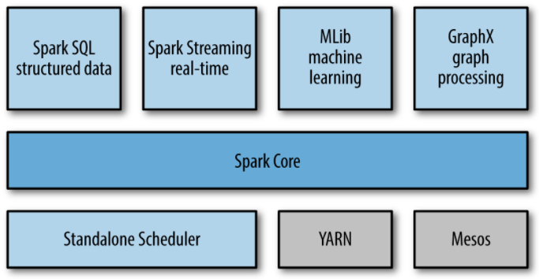
Spark Stack

Slide 19
Python – Lambda Expressions
The lambda operator or lambda function is a way to create small anonymous functions, i.e. functions without a name.
These functions are throw-away functions, i.e. they are just needed where they have been created.
Lambda functions are mainly used in combination with the functions filter(), map() and reduce() (reduce() is no more supported in Python 3.x).
The general syntax of a lambda function is quite simple:
lambda argument_list: expression
The argument list consists of a comma separated list of arguments and the expression is an arithmetic expression using these arguments.

Slide 20

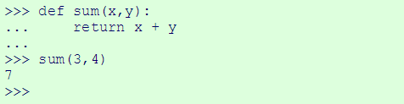
Python – Lambda Expressions
The following example of a lambda function returns the sum of its two arguments:
We could have had the same effect by just using the following conventional function definition:

Slide 21

The map() function
The advantage of the lambda operator can be seen when it is used in combination with the map() function.
map() is a function with two arguments:
The first argument func is the name of a function and the second a sequence (e.g. a list) seq.map() applies the function func to all the elements of the sequence seq.
It returns a new list with the elements changed by func.

Slide 22
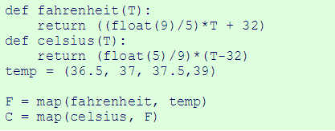
The map() function
The below example of the map() function doesn’t use lambda
By using lambda, we wouldn't have had to define and name the functions fahrenheit() and celsius().

Slide 23
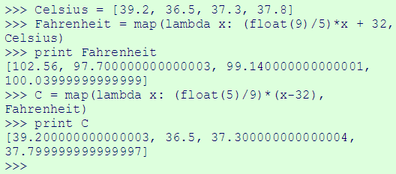
The map() function
The below example of the map() function use lambda

Slide 24
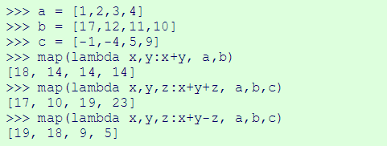
The map() function
map() can be applied to more than one list.
The lists have to have the same length.
map() will apply its lambda function to the elements of the argument lists, i.e. it first applies to the elements with the 0th index, then to the elements with the 1st index until the n-th index is reached.

Slide 25
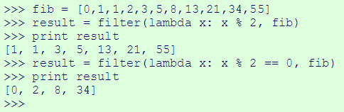
The filter() function
The function filter(function, list) offers an elegant way to filter out all the elements of a list, for which the function function returns True.
The function filter(f,l) needs a function f as its first argument.
  f returns a Boolean value, i.e. either True or False.
This function will be applied to every element of the list l.
Only if f returns True will the element of the list be included in the result list.

Slide 26
The reduce() function
The function reduce(func, seq) continually applies the function func() to the sequence seq. It returns a single value.
If seq = [ s₁, s₂, s₃, ... , s_{n} ], calling reduce(func, seq) works like this:
At first the first two elements of seq will be applied to func, i.e. func(s₁,s₂). The list on which reduce() works looks now like this: [ func(s₁, s₂), s₃, ... , s_{n} ]
In the next step func will be applied on the previous result and the third element of the list, i.e. func(func(s₁, s₂),s₃). The list looks like this now: [ func(func(s₁, s₂),s₃), ... , s_{n} ]
Continue like this until just one element is left and return this element as the result of reduce()

Slide 27

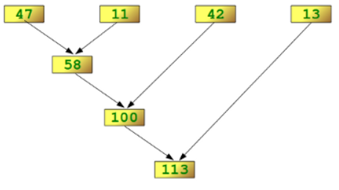
The reduce() function
We illustrate this process in the following example:
The following diagram shows the intermediate steps of the calculation:

Slide 28
Lambda Expressions - Exercise
Login to Canvas and go to the exercise: Module 5 - Exercise - Python Lambda expressions

Slide 29
Databricks
Databricks is a company founded by the creators of Apache Spark, that aims to help clients with cloud-based big data processing using Spark.
Databricks grew out of the AMPLab project at University of California, Berkeley that was involved in making Apache Spark.
Databricks develops a web-based platform for working with Spark, that provides automated cluster management and IPython-style notebooks.

Slide 30
Databricks
Create a community account on Databricks at:
https://accounts.cloud.databricks.com/registration.html#signup/community

Slide 31
Databricks
Login to Canvas and download the notebooks:
Introduction to Databricks
Demo Spark 1
Upload those notebooks to Databricks and start your Apache Spark journey!
More about pyspark API using RDDs at:
https://spark.apache.org/docs/latest/api/python/pyspark.html#pyspark.RDD

Slide 32
References
White, Tom. Hadoop: The Definitive Guide: Storage and Analysis at Internet Scale, O'Reilly Media.
Aven, Jeffrey. Hadoop in 24 Hours, Sams Teach Yourself, Pearson Education.
Sundog Education by Frank Kane, The Ultimate Hands-On Hadoop - Tame your Big Data!
https://databricks.com/blog/2015/06/22/understanding-your-spark-application-through-visualization.html
https://spark.apache.org/docs/latest/cluster-overview.html
https://www.safaribooksonline.com/library/view/learning-spark/9781449359034/ch01.html
https://www.python-course.eu/lambda.php

